Slide 1
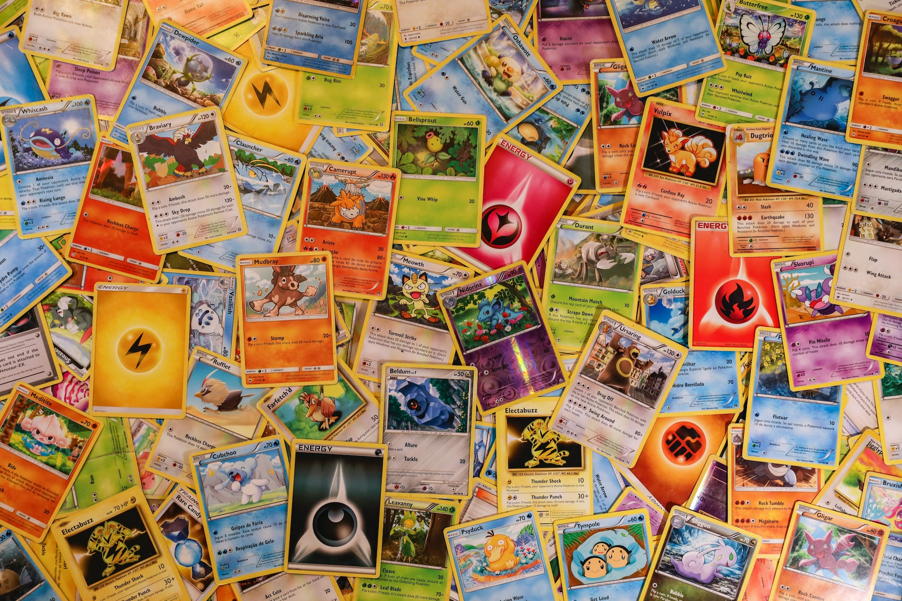
Gotta Analyze ‘Em All Pokémon TCG Price Projections and Analysis
Lora Milam
M.S. Data Analytics, Western Governor’s University
D214: Data Analytics Graduate Capstone
Dr. Daniel Smith
28 November 2023

Slide 2
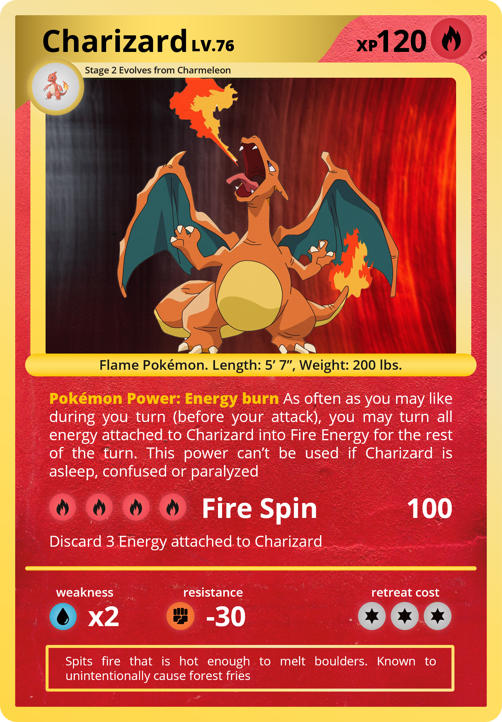
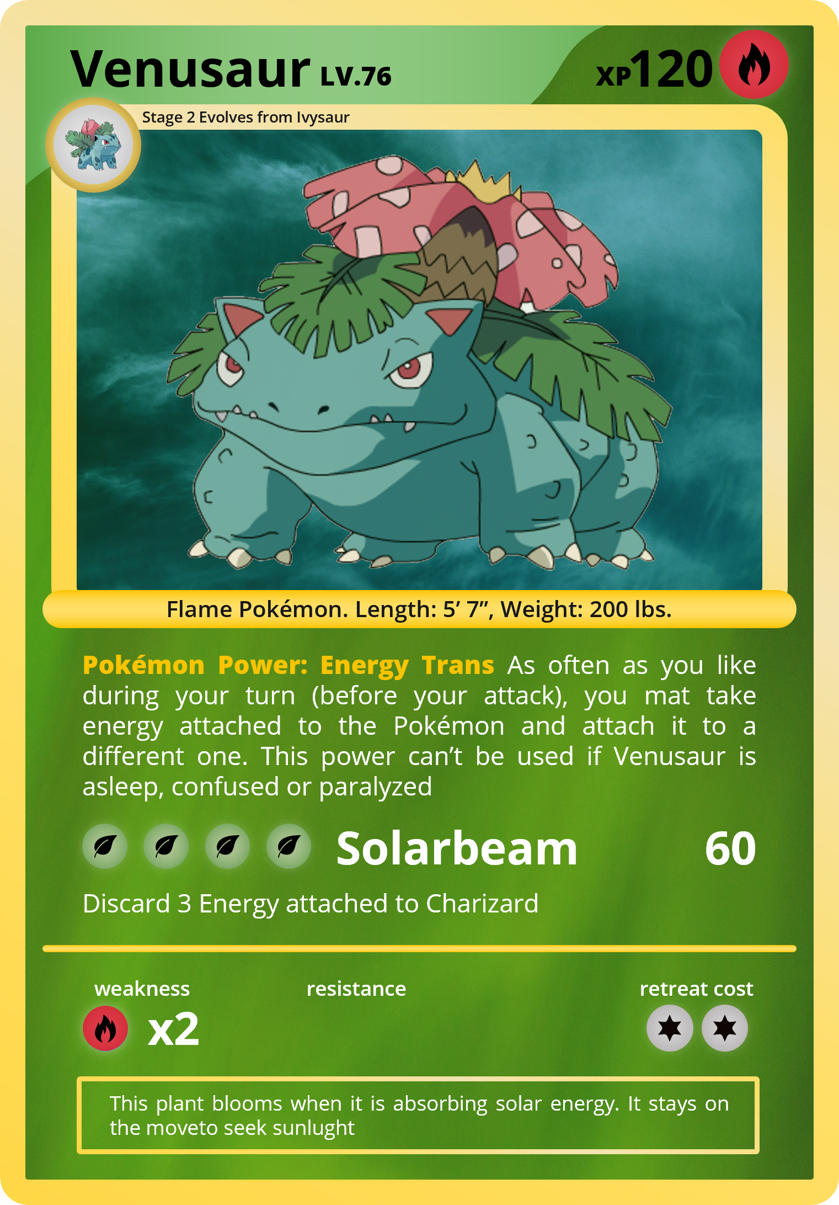
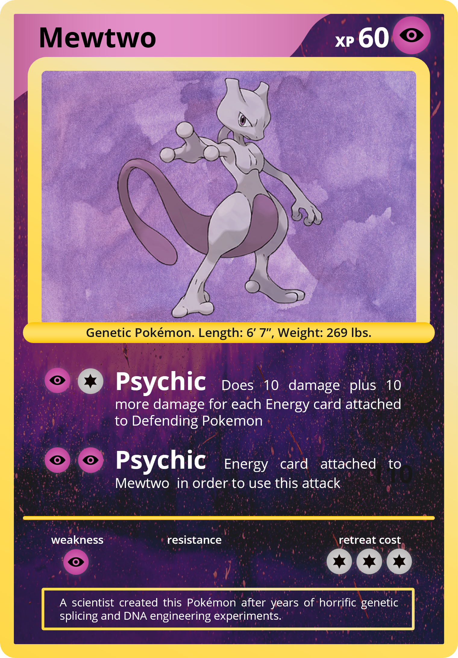
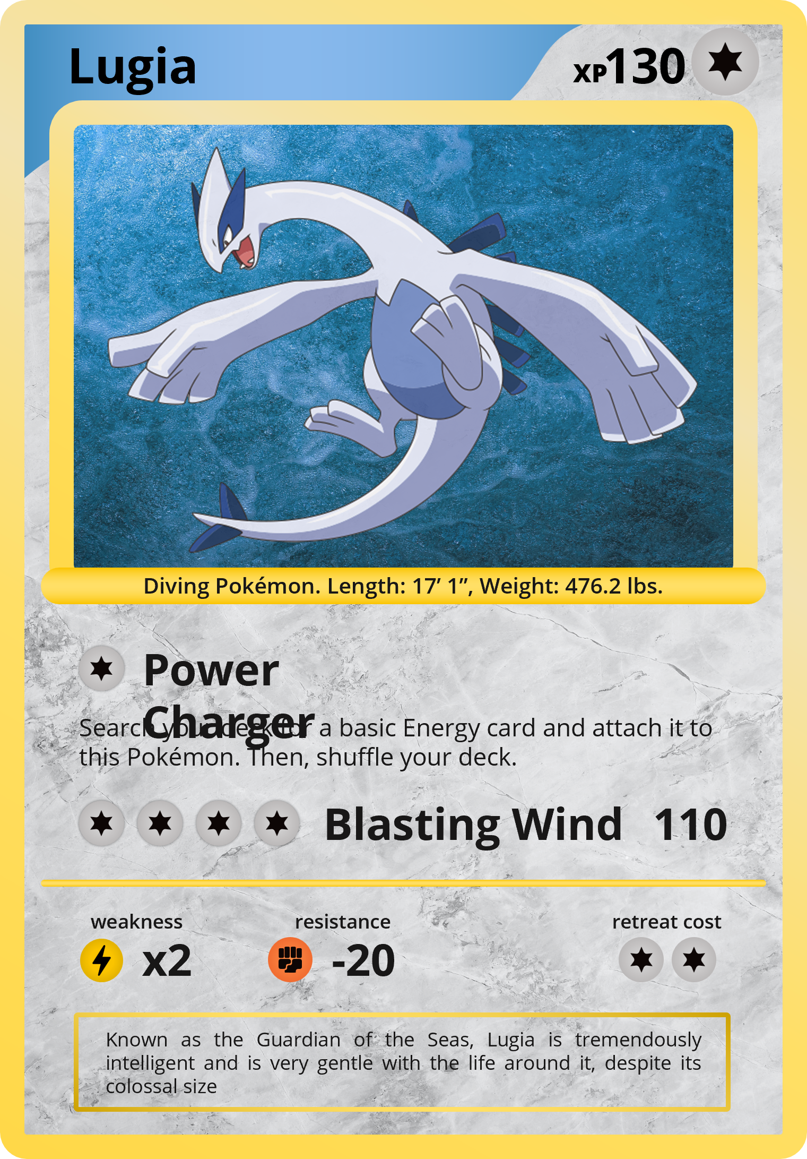
“The Pokémon Trading Card Game, abbreviated as PTCG or Pokémon TCG, is a collectible card game based on the Pokémon franchise. It was first published in October 1996 by Media Factory in Japan. In the US, it was first published by Wizards of the Coast. In June 2003, Nintendo transferred the publishing rights from both Media Factory and Wizards of the Coast to The Pokémon Company.” (SlideChef)

Slide 3
Collecting Pokémon Cards
“Collecting Pokémon cards is a fun, interactive hobby for anyone and everyone. These Japanese "pocket monster" cards can be used to play the Pokémon trading card game or you join the people across the world collecting cards to try and "catch 'em all"!” (SlideChef)

Slide 4
Why Are Pokémon Cards So Expensive?
“Pokémon cards are some of the most popular and expensive trading cards available. While there are many reasons for their high prices, the most significant contributing factor is the limited availability of certain cards. Card collectors and traders are always looking to get their hands on rarer cards, which further drives up the prices.” (SlideChef)

Slide 5
Statement of the Problem and Hypothesis
The complexity of the Pokémon TCG market
Challenges for investors seeking the highest ROI
Research question focuses on Double Rare and above for recent sets and Rare and above for older sets
Hypothesis: Meticulous data analysis can identify Pokémon cards with consistent value appreciation

Slide 6
Summary of the Data-Analysis Process
Data gathered from diverse platforms
Including pull rates, hits, and pricing information
Manual surveys and adaptation methods addressed challenges
Tableau chosen for visualization capabilities and relationship simplification
Various analysis techniques applied, including market price comparisons, pull rates, and forecasting in Tableau

Slide 7
Outline of Findings
Cost-effective booster pack and box purchases
Statistically significant card types and subsets with high pull rates
Most valuable Pokémon cards based on market prices
Lowest cost associated with organically pulling specific Pokémon cards
Statistically, no individual Pokémon card worth the cost of organic pulling
Tableau's forecast on market price history, aiding in future investment decisions

Slide 8
Cost-effective Booster Pack and Box Purchases
Cheapest Booster Packs
Cheapest Booster Boxes
Set | Subset | Price (USD $)
Scarlet&Violet | Paldea Evolved | $2.79
Sword&Shield | Silver Tempest | $2.96
Scarlet&Violet | Base Set | $2.99
Scarlet&Violet | Paradox Rift | $3.19
Sword&Shield | Astral Radiance | $3.23
Sword&Shield | Lost Origin | $3.36
Sword&Shield | Battle Styles | $3.39
Sword&Shield | Vivid Voltage | $3.41
Sword&Shield | Fusion Strike | $3.49
Set | Subset | Price (USD $)
Scarlet&Violet | Base Set | $86.93
Scarlet&Violet | Paradox Rift | $88.98
Scarlet&Violet | Paldea Evolved | $94.74
Sword&Shield | Battle Styles | $105.2
Sword&Shield | Silver Tempest | $111.31
Sword&Shield | Darkness Ablaze | $129.32
Sword&Shield | Lost Origin | $129.69
Sword&Shield | Vivid Voltage | $130.61
Sword&Shield | Astral Radiance | $130.91

Slide 9
Card Types and Subsets with High Pull Rates
Pull Rates Vs Card Type
Pull Rates Vs Card Sub-Type
Pack # | Set | Subset | Card Type
1 | Legendary Collection | Base Set | Rare
2 | Gym | Heroes | Rare
2 | Neo | Destiny | Rare
2 | Neo | Discovery | Rare
2 | Neo | Revelation | Rare
2 | Original | Base Set 2 | Rare
2 | Original | Fossil | Rare
2 | Original | Team Rocket | Rare
2 | Sword&Shield | Celebrations | Rare
Pack # | Set | Subset | Card Type | Card Sub-Type
1 | Legendary Collection | Base Set | Rare | Reverse Holo
3 | Gym | Heroes | Rare | Pokemon
3 | Legendary Collection | Base Set | Rare | Pokemon
3 | Neo | Destiny | Rare | Pokemon
3 | Neo | Discovery | Rare | Pokemon

Slide 10
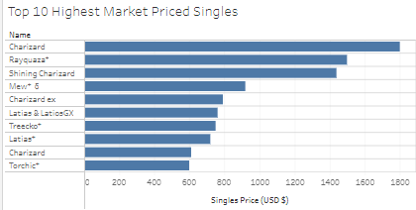
Most Valuable Pokémon Cards Based on Market Prices

Slide 11
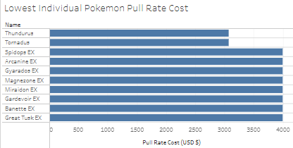
Lowest Pull Rate Cost

Slide 12
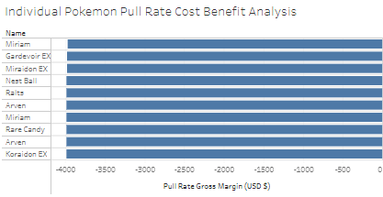
Gross Fiscal Margin

Slide 13
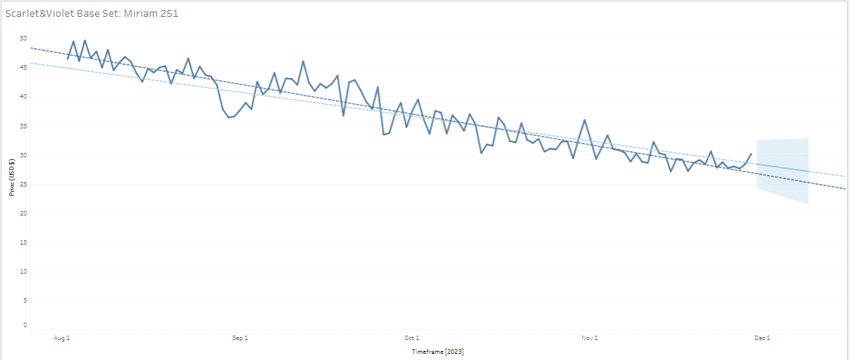
Forecasting

Slide 14
Explanation of Limitations of Techniques and Tools Used
Complexity in calculating the lowest individual pull rate cost
Reliance on assumptions in Tableau's forecasting
Acknowledging potential challenges in a dynamic market

Slide 15
Summary of Proposed Actions
Investors recommended to reconsider the strategy of organically pulling specific Pokémon cards
Calculated costs outweigh potential profit margins
More cost-effective approach involves strategic purchasing of specific cards from the market

Slide 16
Expected Benefits of the Study
Strengthening forecasting algorithms with additional data
Streamlining the data collection process for real-time insights from market price platforms

Slide 17
Thank - You

Slide 18
Sources
SlideChef. (2022, October 27). Free google slides pokémon cards template powerpoint. https://slidechef.net/templates/free-pokemon-cards-template/

Slide 19

Slide Chef

